Slide 1


Brainware University
INVENTORY (WAREHOUSE) STOCK MANAGEMENT SYSTEM PROBLEM AND SOLUTION ANALYSIS
Presented By:
Purnima Maity (BWU/MCA/22/004)
Sumit Sur (BWU/MCA/22/005)
Abhijit Haldar (BWU/MCA/22/012)
Subhranil Bhattacharjee(BWU/MCA/22/008)
Submission Date:25/11/23

Slide 2
Introduction
This thesis explores Inventory Warehouse Management Systems (IWMS), looking at problems like having too little or too much stock. It emphasizes how the Internet of Things (IoT) can transform forecasting, providing smart solutions to make warehouse management more efficient and adaptable. Essentially, it's about using technology to navigate the challenges of modern markets and keep a balance between supply and demand.
Notes:
Image source: https://en.ppt-online.org/339855

Slide 3
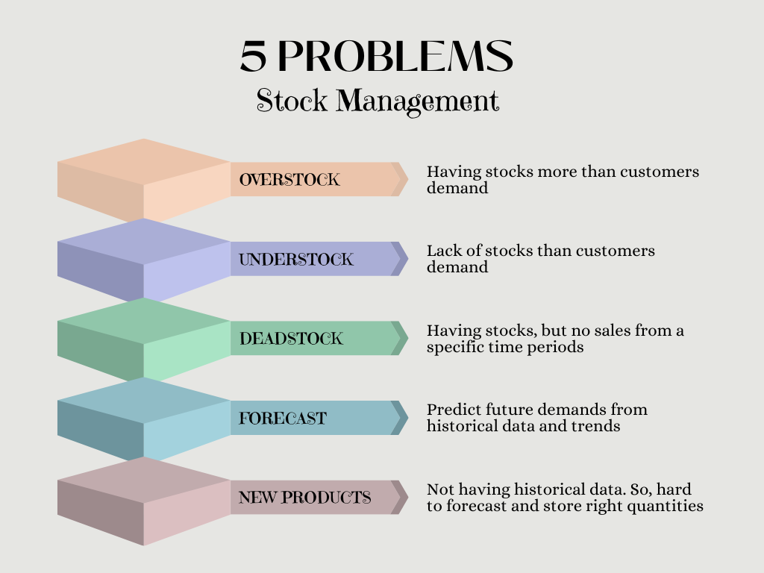
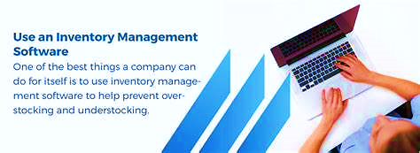
SOLUTION
Notes:
Image source: https://cashflowinventory.com/blog/overstocking-and-understocking/

Slide 4

Scope
It helps to ensure that all stocks are accounted for and that there is no waste due to unused products.
It is simpler and easier to mount. As the user can clearly see the real-time value of the product container, it is easy to track product items. The threshold value is chosen so that product stocks are sufficient for use until the new stocks arrive.
It makes it easier to spot issues or trends that could impact your business, like a sudden increase in demand for a particular item.
Notes:
Image source: https://en.ppt-online.org/339855

Slide 5
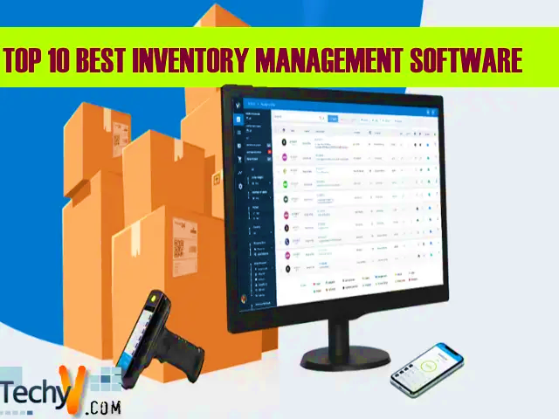
Purpose
Using software for inventory management offers advantages over manual methods by improving accuracy, speed, and overall efficiency. It helps automate tasks such as inventory tracking, order processing, and data analysis, reducing human errors and increasing productivity. Additionally, software provides real-time visibility into warehouse operations, aiding in better decision-making and responsive management of inventory levels.
Notes:
Image source: https://en.ppt-online.org/339855

Slide 6
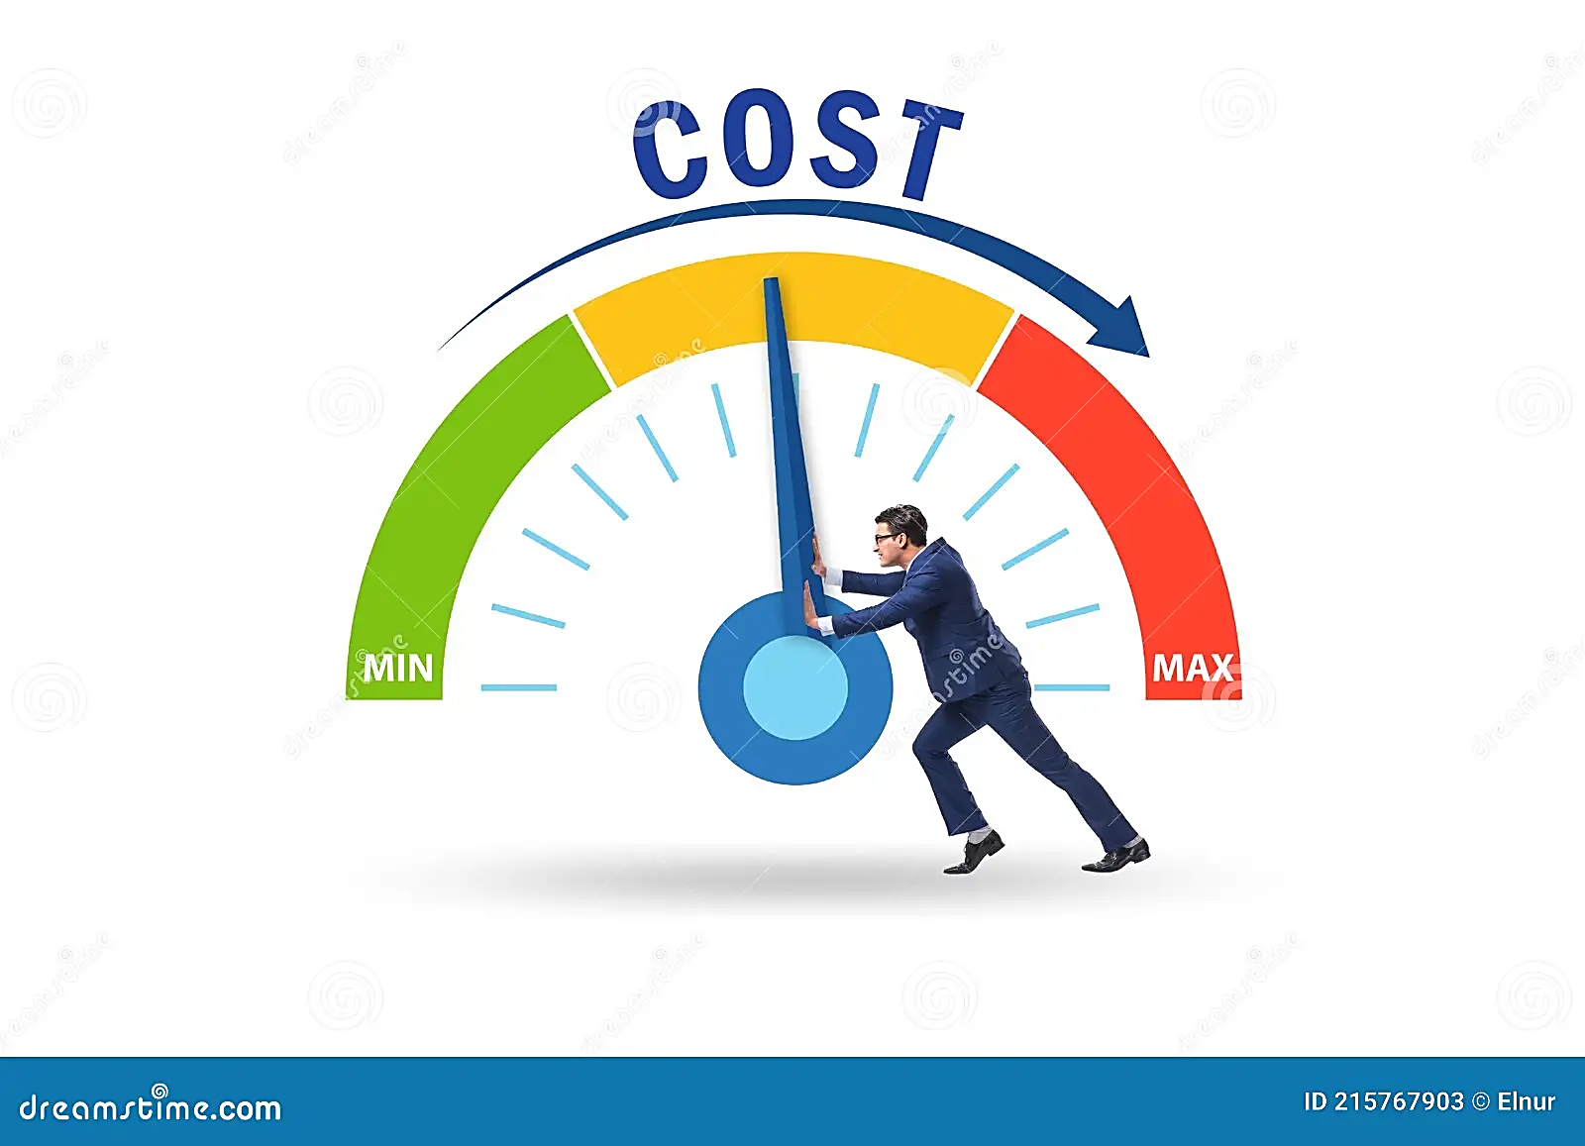


Objective:
Cost Control
Efficient Inventory Management
Optimizing Stock Levels:
Notes:
Image source: https://cashflowinventory.com/blog/overstocking-and-understocking/

Slide 7
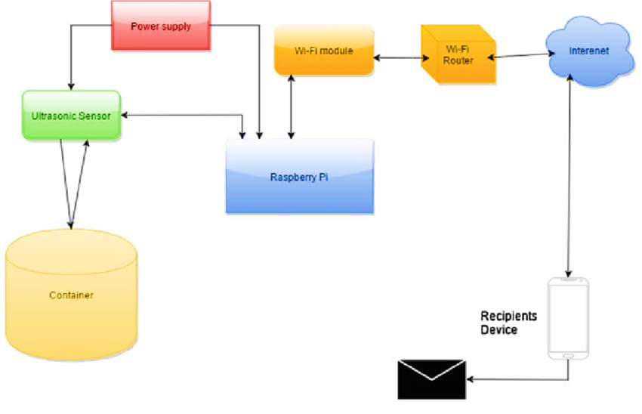
Functional block diagram of the proposed design:
Notes:
Image source: https://en.ppt-online.org/339855

Slide 8
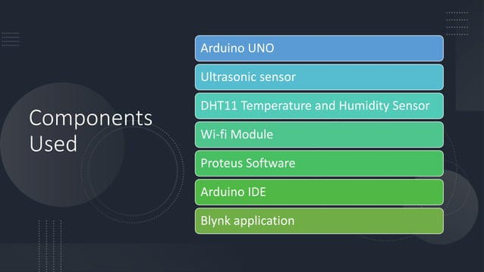
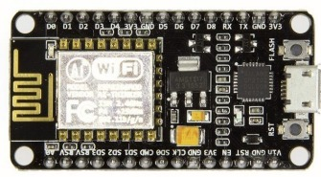
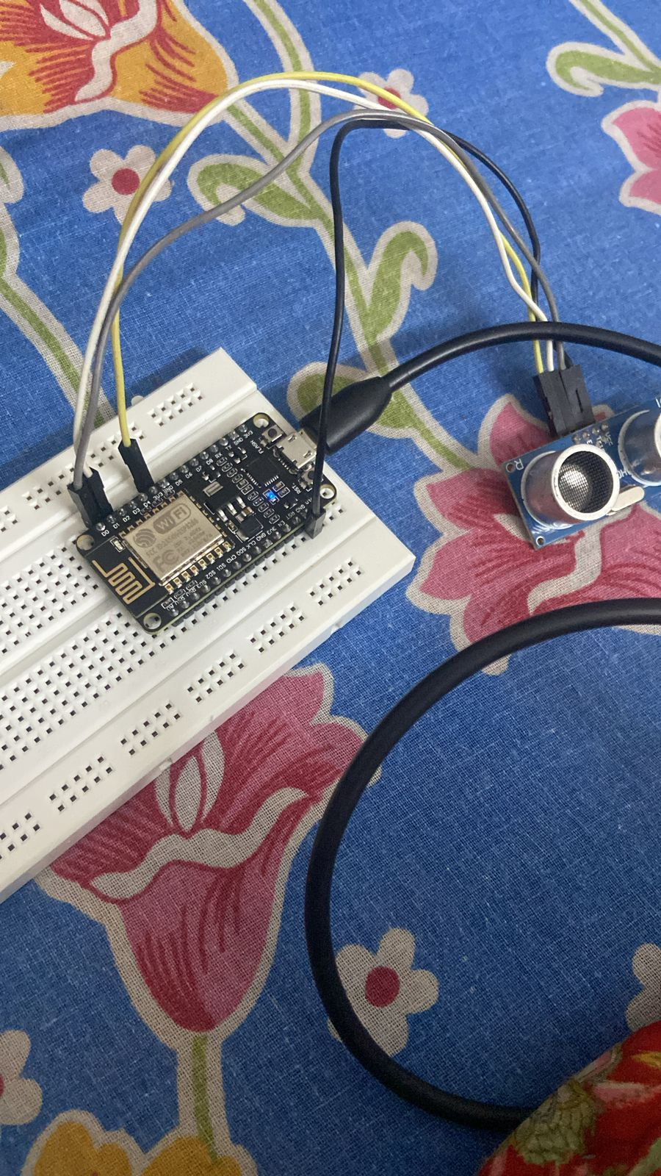
NodeMCU
Ultrasonic Sensor
IFTTT
Jumper wires
Arduino IDE
ThingSpeak
USB connector

Slide 9
Methodologies
STEP 1: Ultrasonic Sensors sense the event.
STEP 2: ThingSpeak is used to track the inventory.
STEP 3: The system is connected to the Internet using a wireless Wi-Fi module NodeMCU.
STEP 4: Creates an EmaiL.
STEP 5: System sends a mail to alert understock.
Notes:
Image source: https://en.ppt-online.org/339855

Slide 10
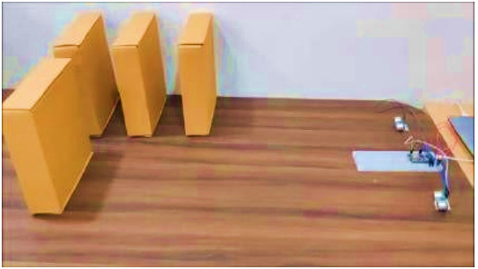
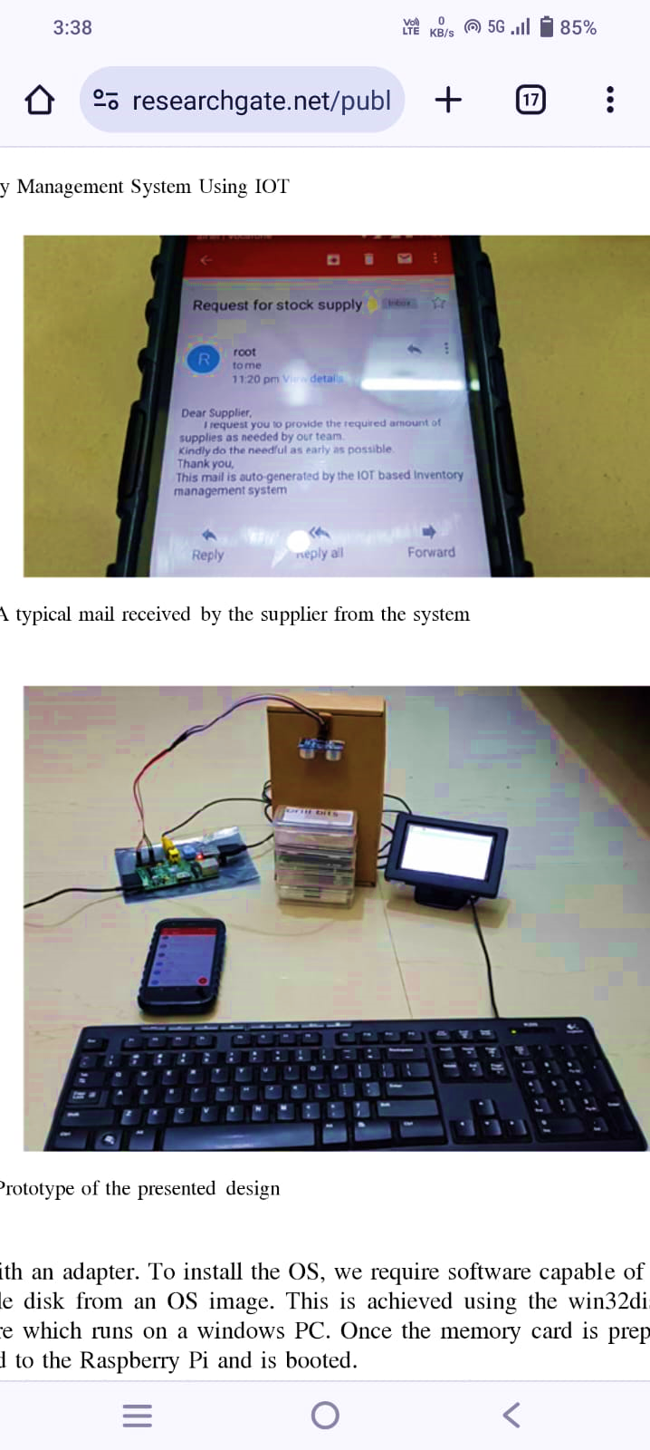
Prototype
Notes:
Image source: https://en.ppt-online.org/339855

Slide 11

Conclusion
Implementing an IoT-based food inventory system offers advantages such as real-time visibility, improved accuracy, and enhanced efficiency in managing and tracking products.
Notes:
Image source: https://en.ppt-online.org/339855

Slide 12
References
1. EunSu Lee, Kambiz farahmand “Simulation Of A Base Stock Inventory Management System
Integrated With Transportation Strategies Of A Logistics Network,”Proceedings of the 2010
Winter Simulation Conference.
2. O. Jukic, I. Hedi, “Inventory management system for water supply network,”MIPRO 2014,
26–30 May 2014, Opatija, Croatia.
3. Liling Xia, “The Design and Implementation of Distributed Inventory Management System
Based on the Intranet Architecture,”Proceedings of the IEEE, International Conference on
Information and Automation, Shenzen, China June 2011.
Notes:
Image source: https://en.ppt-online.org/339855

Slide 13


